Slide 1
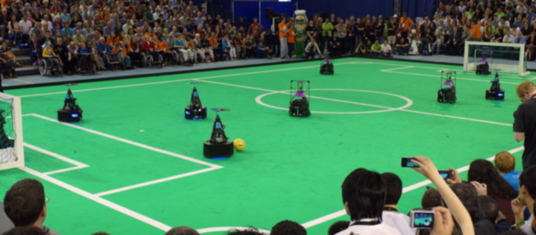
Kick-off meeting MSD project - AutoRef
05/02/2024
Quinten Swaan, Project Manager
Department of Mathematics and Computer Science, EngD. Mechatronic Systems Design

Slide 2
Agenda
Introductions
Project introduction and discussion
Communication and meetings
Next steps
Summary
11:00 – 11:10
11:10 – 12:05
12:05 – 12:15
12:15 – 12:25
12:25 – 12:30

Slide 3
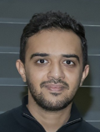


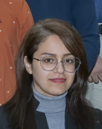
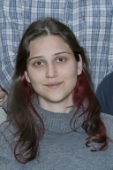

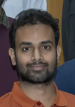
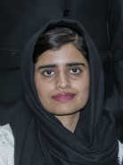
Introductions
Kareem
Ghedan
Joseph
Tandio
Quinten
Swaan
Mahsa
Barghi Mehmandari
Team
Leader
System
Architect
Project
Manager
Scrum
Master
Design
Engineer
Design
Engineer
Design
Engineer
Design
Engineer
Deniz
Akyazi
Anshid
Pillat
Arjun
Chauhan
Naheed
Tabassum
Design
Engineer
Design
Engineer
Design
Engineer
Design
Engineer

Slide 4
Project
Problem
Project’s goal
Deliverables
Future work
Opinion on previous years
Preference added rules
Hardware availability/adding
Simulation possibility
Platform
Data sources
RefBox

Slide 5
Communication and meetings
How can we communicate
Whom to contact
Plan new meetings

Slide 6
Action points
Define project scope
Project management plan
Project planning

Slide 7
Summary

Slide 8
Previous years
"To have a 5 minute long 2 against 2 robot soccer game, using the Tech United turtles, refereed by the system described above, which receives a positive recommendation by an experienced human referee. By positive recommendation we mean that the human referee acknowledges that the provided refereeing system, for that 5-minute-long game, refereed the match well."

Slide 9


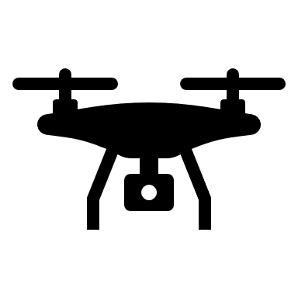

Previous years
2016 - 2019
2020
2021
2022
Drone based system
Emphasized on continuity
Pivot Table
Top camera
Distance violation ball – player
TURTLE data
Ball out of play
Ball rolled freely after kick
Stadium camera’s
Checking set piece
Object detection

Slide 10
Previous years
Most important concerns
Extendibility and continuity
Fairness
Positive feedback from human referee
Integration with Tech United

